Slide 1



UNIT 8: Fit and healthy
What happened?

Slide 2
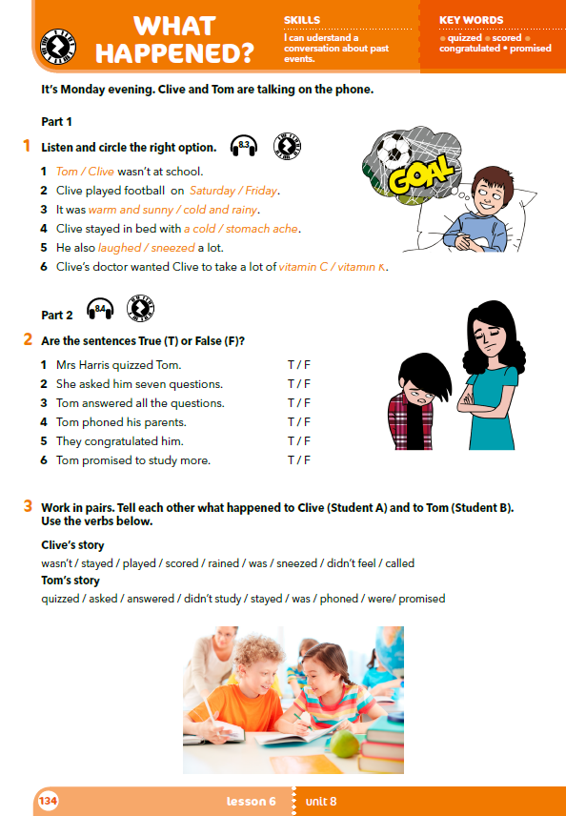
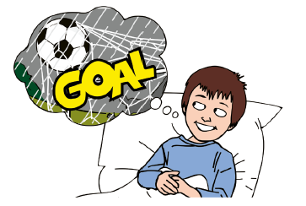
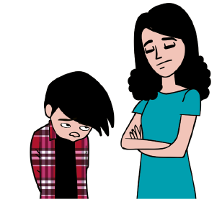
The boys in the pictures are Clive and Tom.
Which one do you think is Tom?
Which one is Clive?
How is the boy in the first picture feeling?
What do you think happened to him?
What about the boy in the second picture?
Who is the lady next to him?

Slide 3
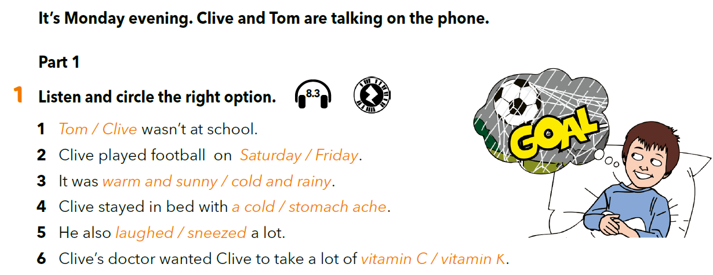

https://www.e-sfera.hr/dodatni-digitalni-sadrzaji/93880e63-cf6a-4dcd-a297-a1373272e50d/assets/audio/62_clive_and_tom_1.mp3

Slide 4
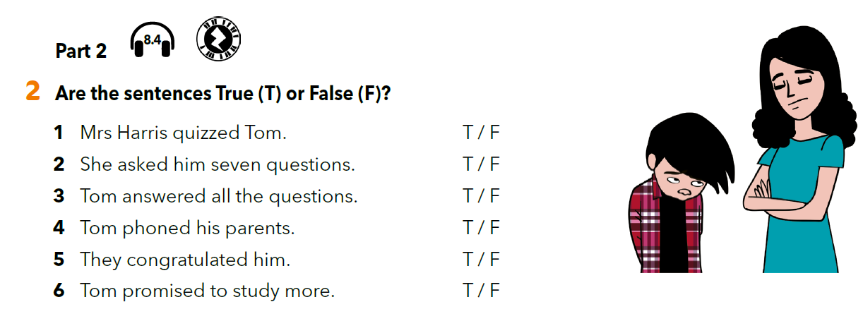
https://www.e-sfera.hr/dodatni-digitalni-sadrzaji/93880e63-cf6a-4dcd-a297-a1373272e50d/assets/audio/63_clive_and_tom_part_2.mp3

Slide 5
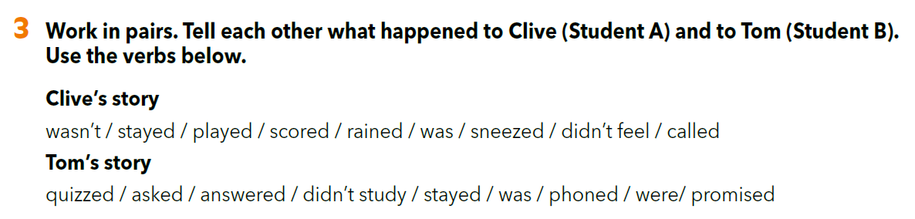
U malim grupama odaberite pet glagola iz popisa u trećem zadatku i osmislite nastavak priče o Cliveu ili Tomu. Svaki učenik iz grupe treba znati prepričati priču koju ste smislili.

Slide 6
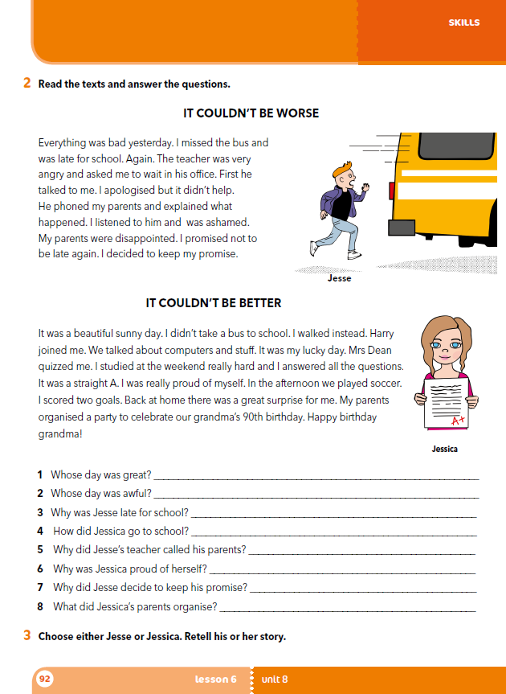
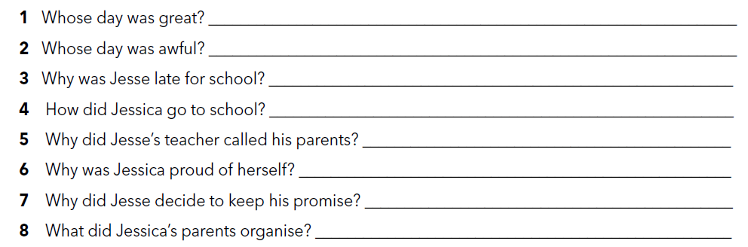
workbook p 92.
Jessica’s day was great.
Jesse’s day was awful.
Jesse was late for school because he missed the bus.
Jessica walked to school.
Jesse’s teacher called his parents because he was late for school again.
Jessica was proud because she answered all the questions right.
Jesse decided to keep his promise because he was ashamed and his parents were disappointed.
Jessica’s parents organised a party to celebrate their grandma’s 90th birthday.

Slide 7
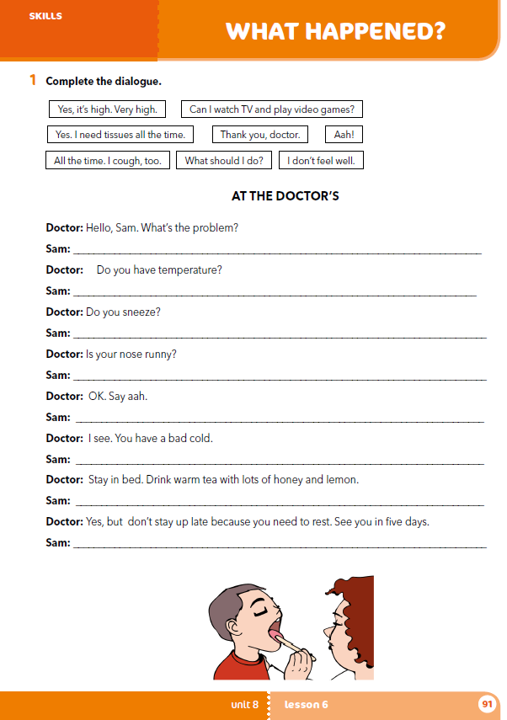
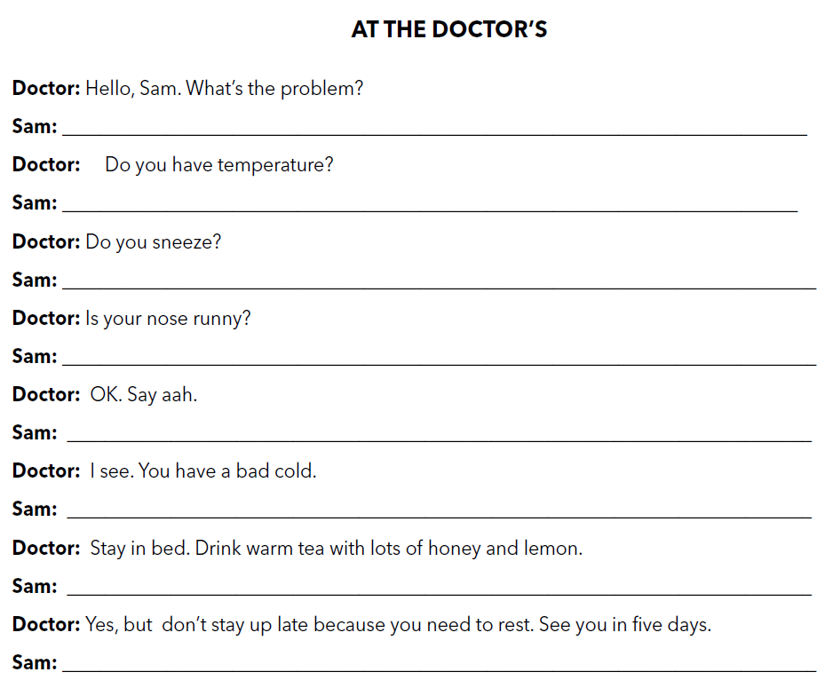
Workbook p. 91
I don’t feel well.
Look at the picture. Where is Sam?
Why do you think he’s there?
When was the last time you were at the doctor’s?
Why? What happened?
Yes, it’s high. Very high.
All the time. I cough, too.
Yes. I need tissues all the time.
Aah!
What should I do?
Can I watch TV and play video games?
Thank you, doctor.

Slide 8
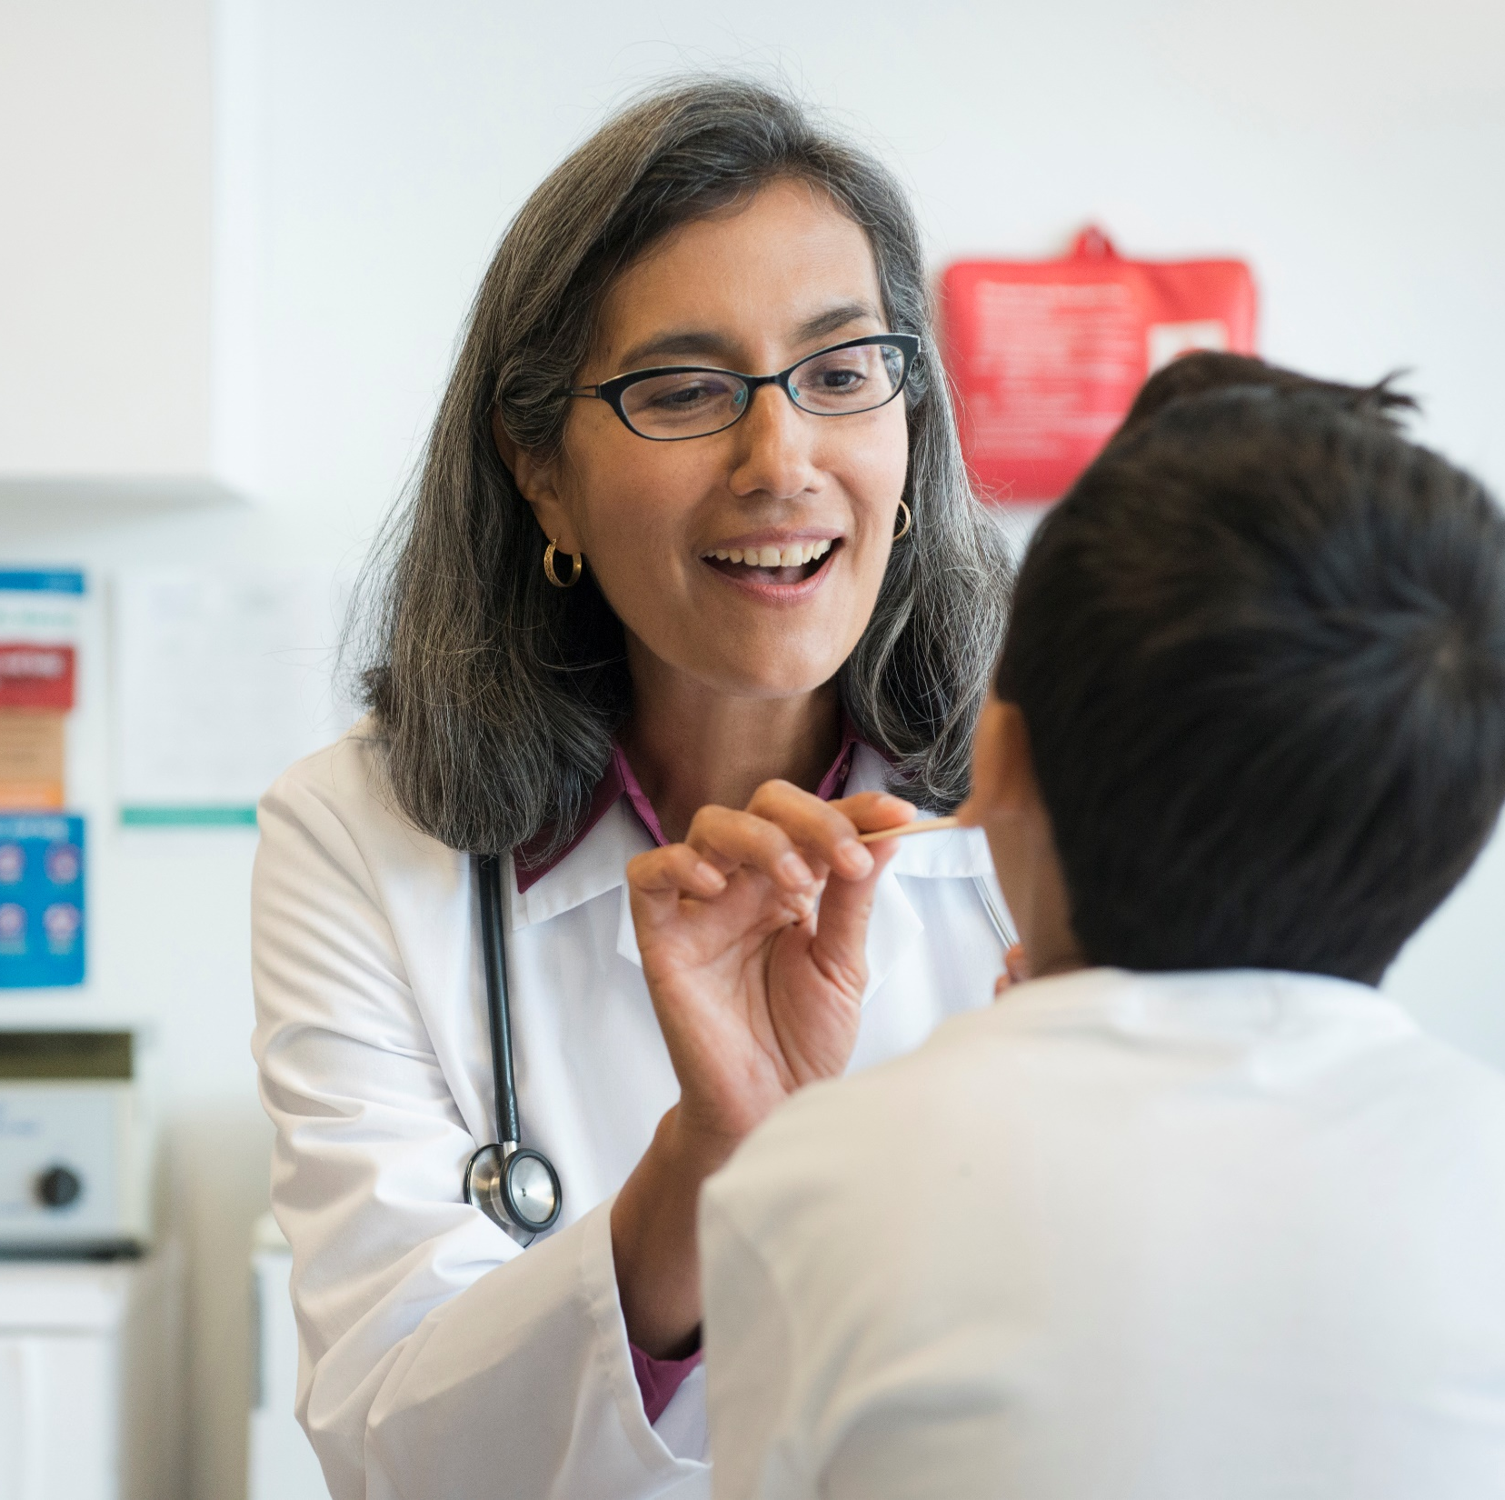
Na temelju dijaloga iz zadatka uvježbajte skeč u paru.
Odaberi najmanje dva simptoma i, u paru, osmislite novi skeč.

Slide 9
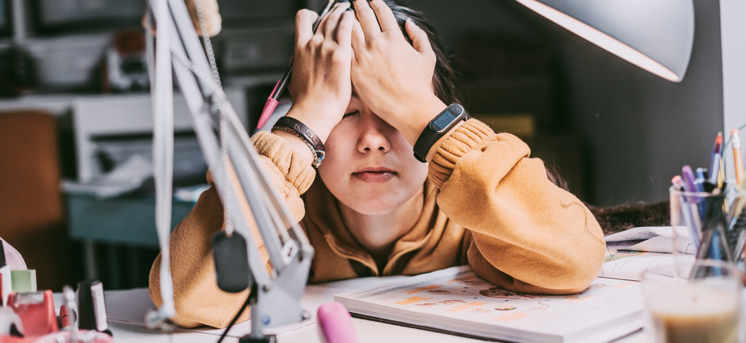
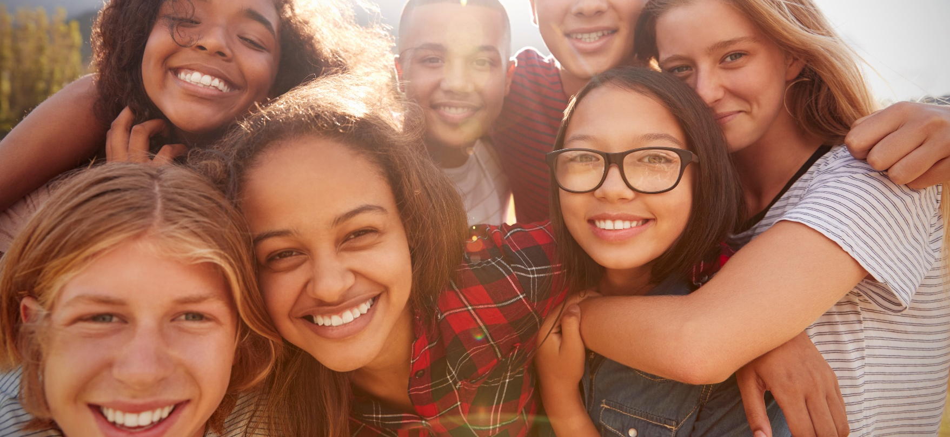
Write a story (50-60 words) about one very good or very bad day that you had.
Use the texts from lesson 6 as an example.

Slide 10

LET’S REVISE!
PLAY AND LEARN
https://www.e-sfera.hr/dodatni-digitalni-sadrzaji/4c3cd197-6f47-499b-8510-fa81e51a252a/
LEARN MORE
https://www.e-sfera.hr/dodatni-digitalni-sadrzaji/4c3cd197-6f47-499b-8510-fa81e51a252a/
A phone call

